Slide 1

From the creators of
Absolutely nothing else ever…

Slide 2
The amazein snek
An Eel Encorporated production

Slide 3

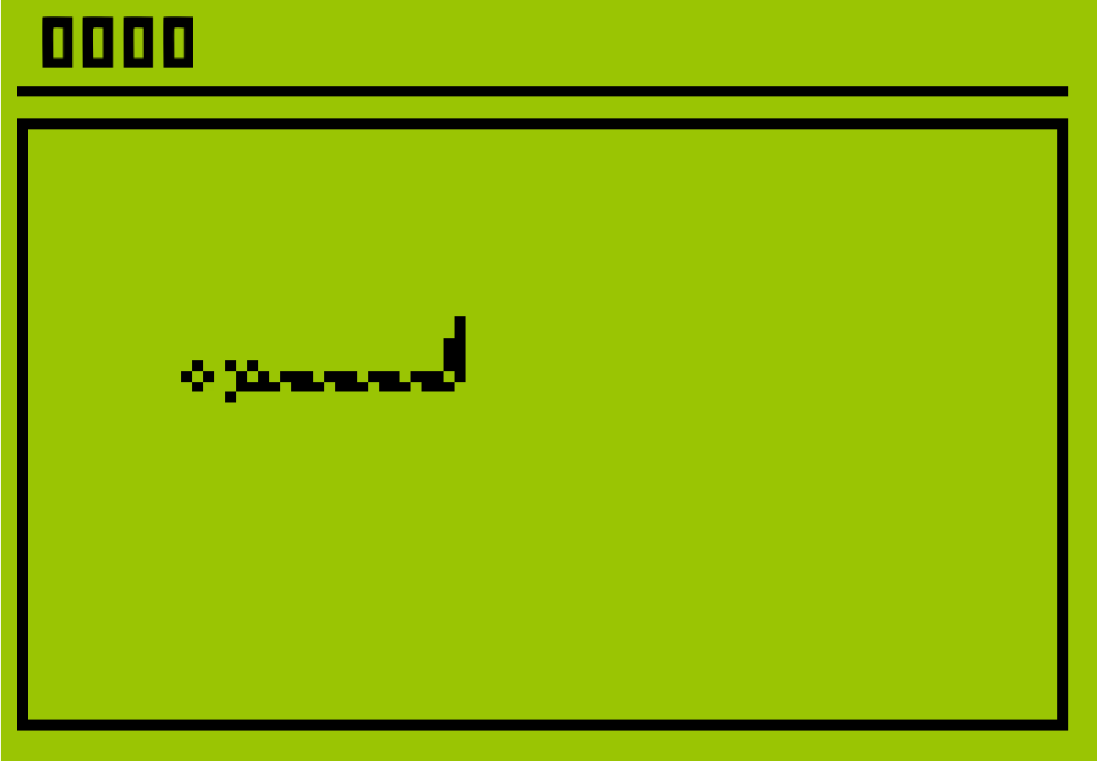
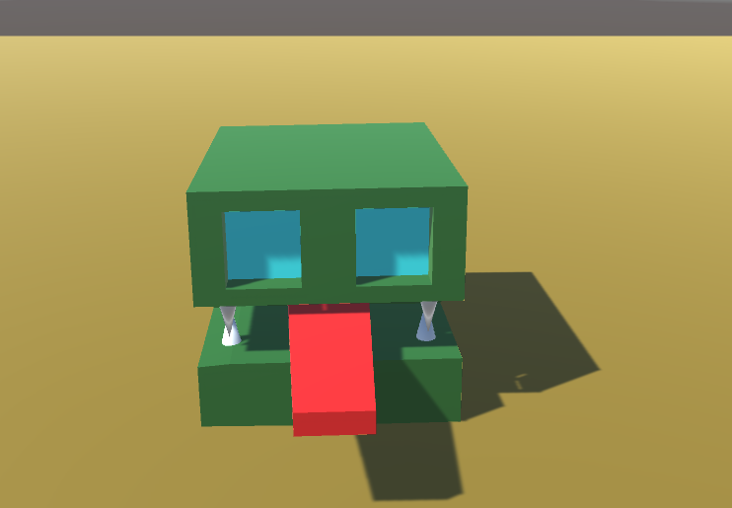
Edge of your seat action
Fun for EVERYONE!
Challenging puzzles

Slide 4
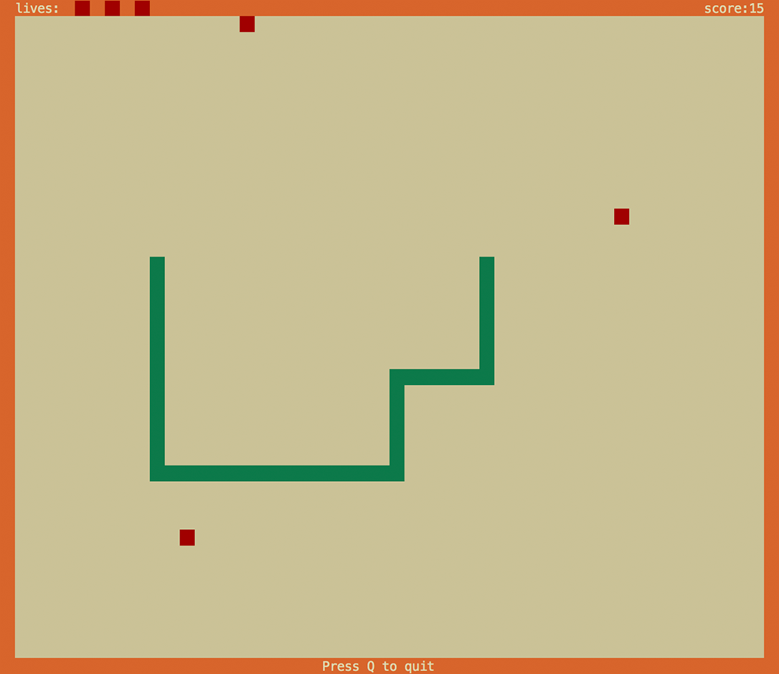
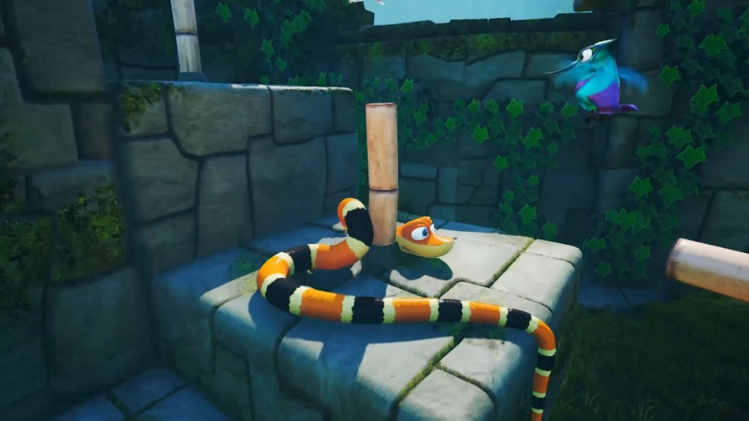
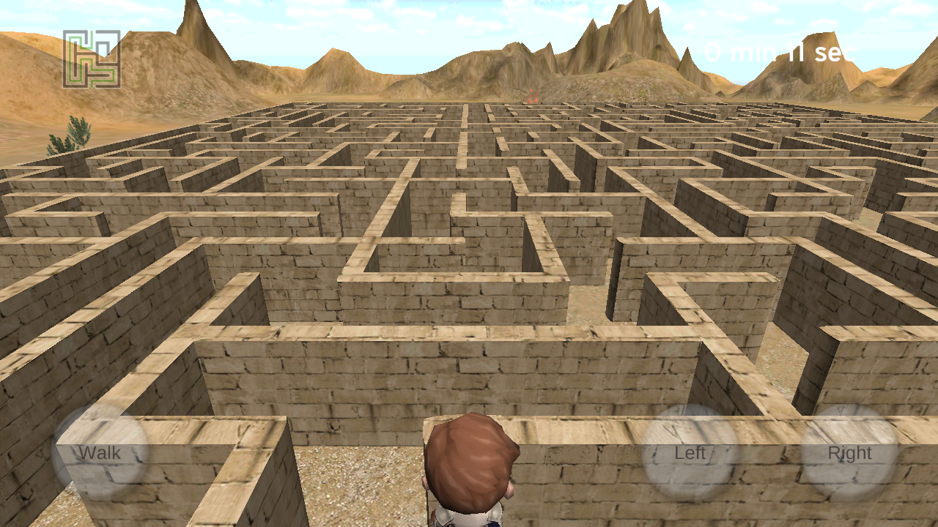
Mood board
Snake Pass tail trailing
Labyrinth camera view
Traditional snake tail growth

Slide 5
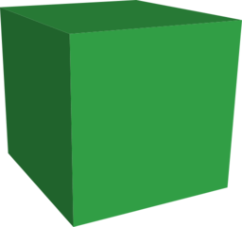
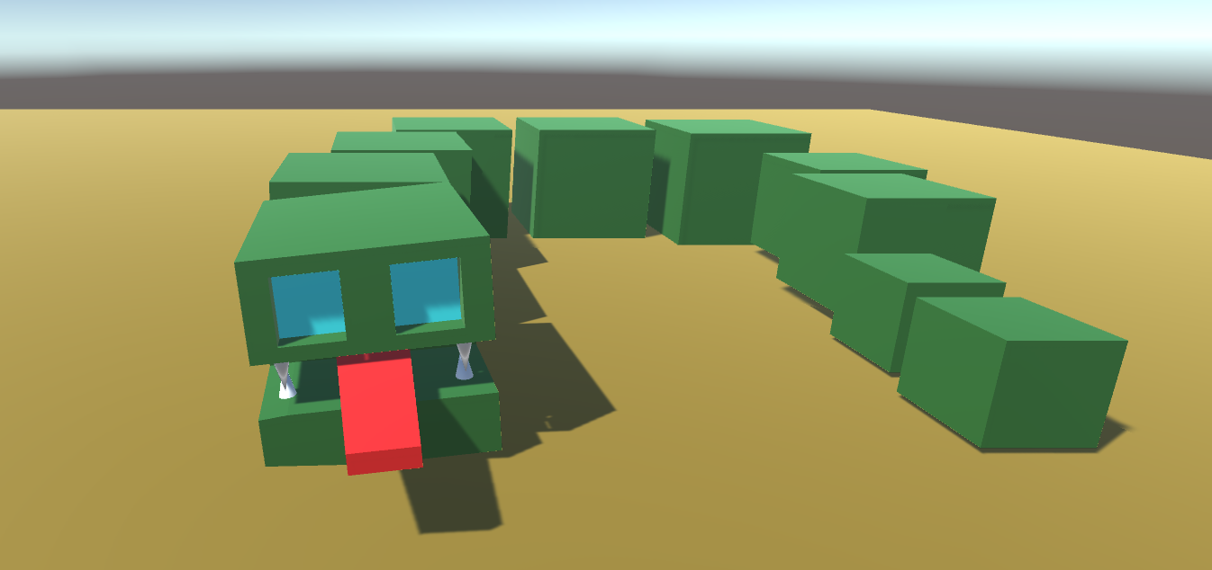
Concept Art
Progression Cubes
Snek
Grown Snek
+
=

Slide 6
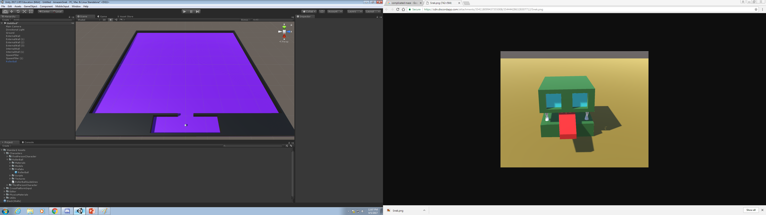
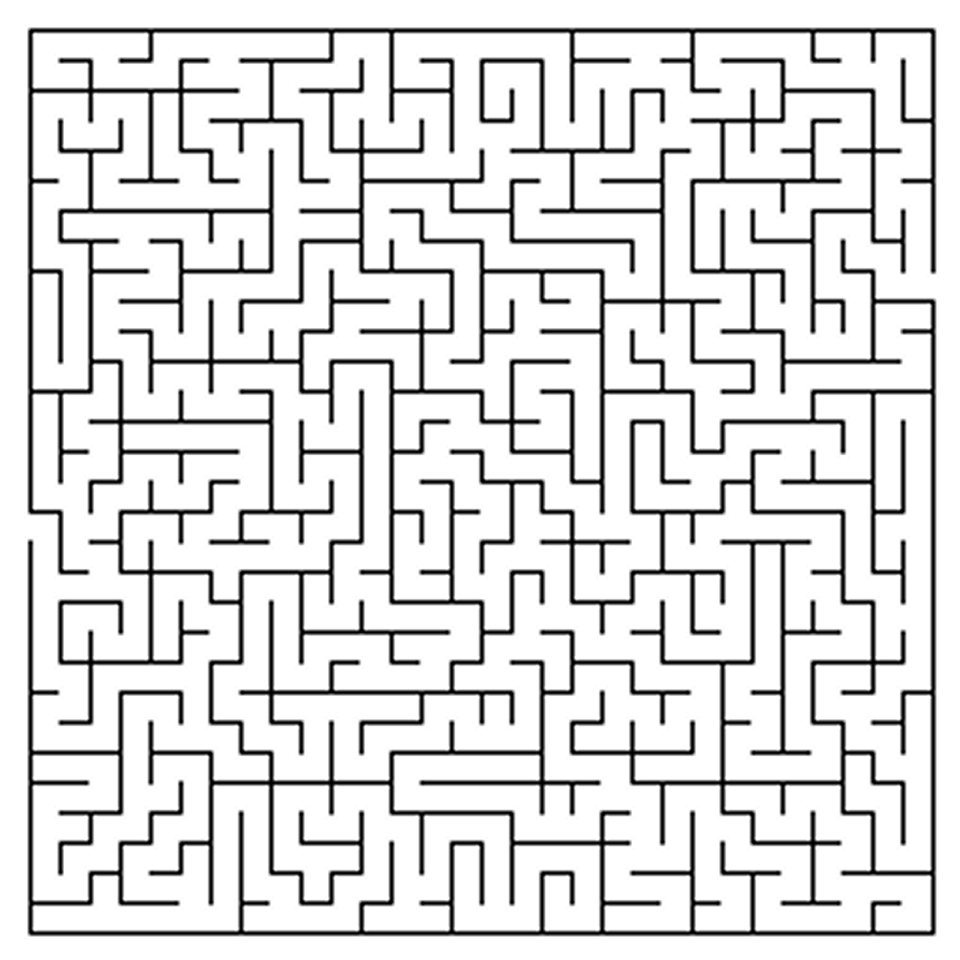
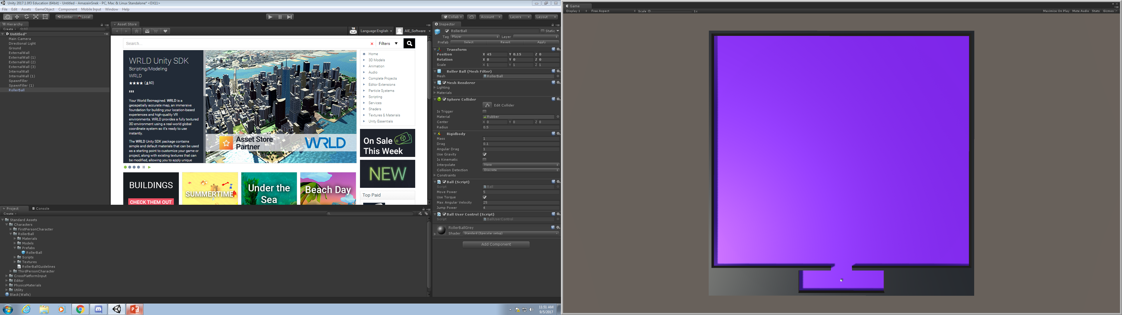
Concept Art
Potential Map
Player Progression
Players view of
Snek
(with alternative orientations)

Slide 7




Coming soon to a console near you

Slide 8
Releasing this Spring!!

